Slide 1
SNN

Slide 2
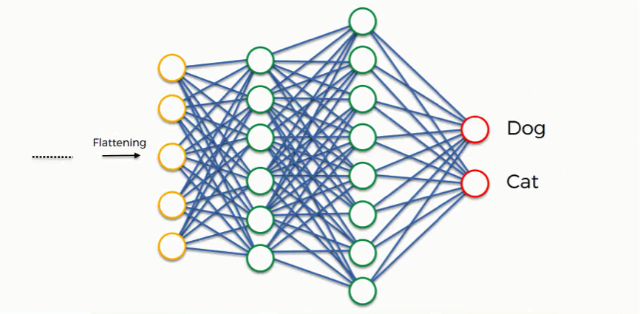
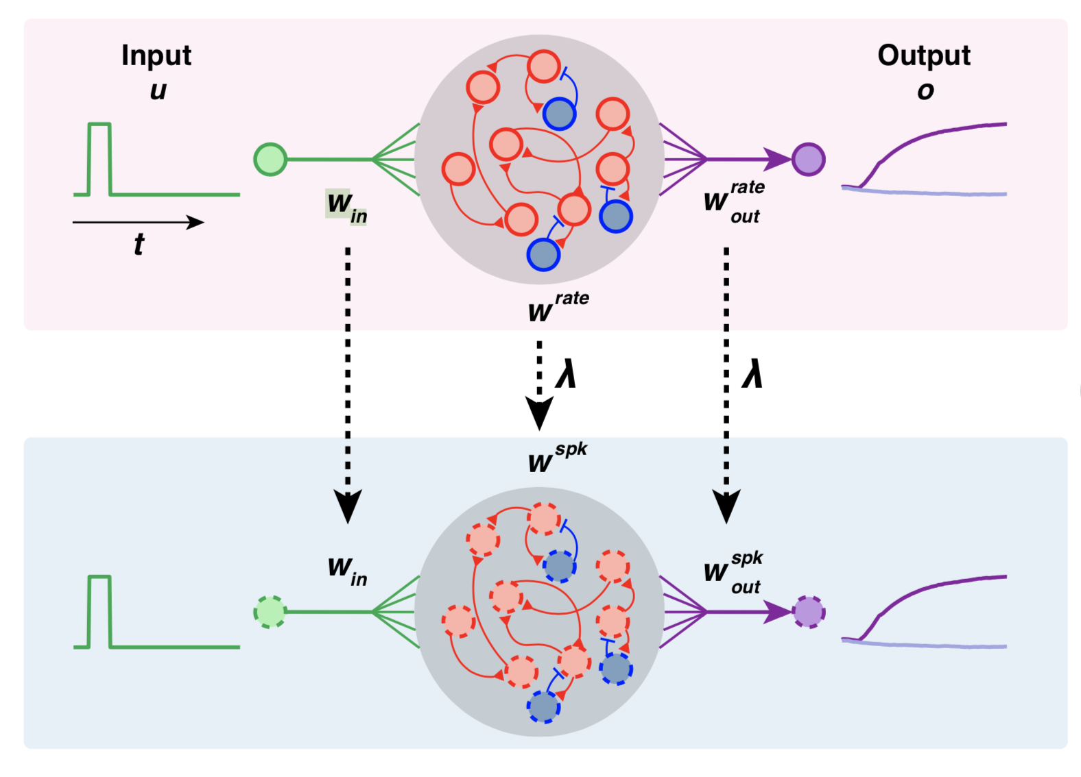
Trade-offs
Accuracy
Accuracy
Power Consumption
Power Consumption

Slide 3
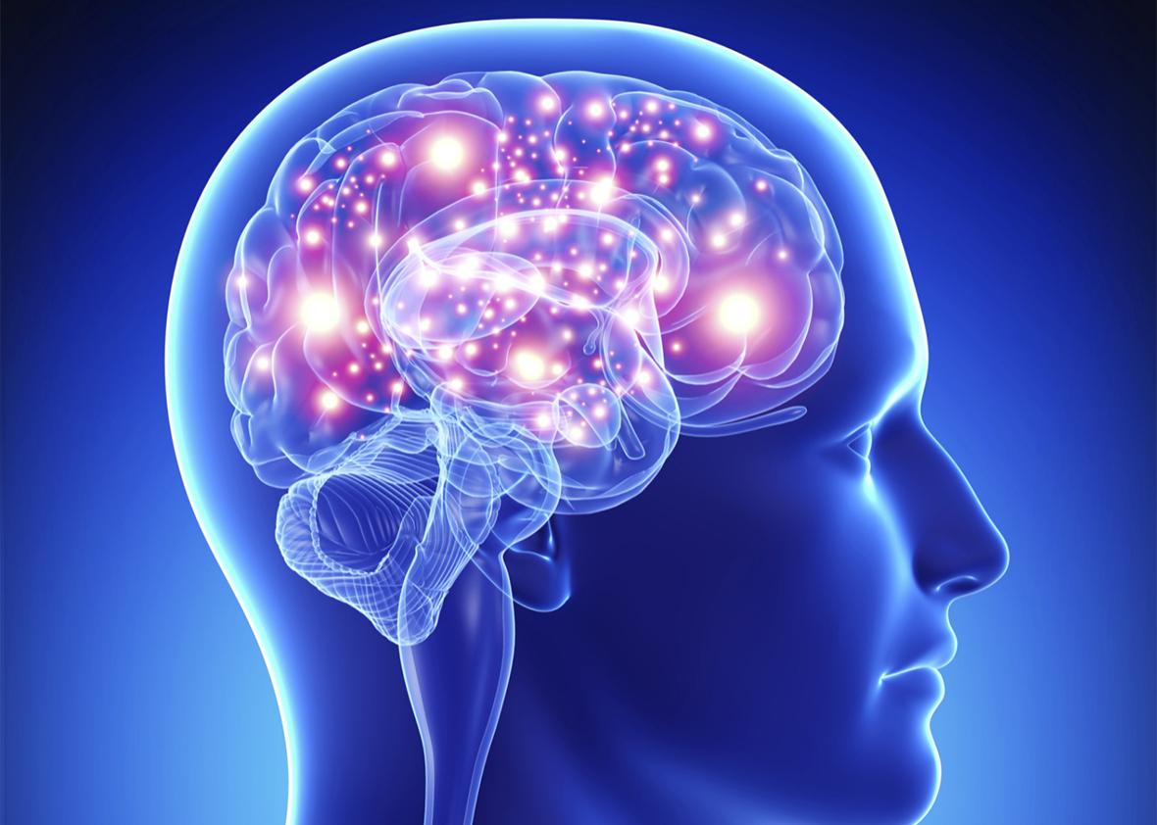
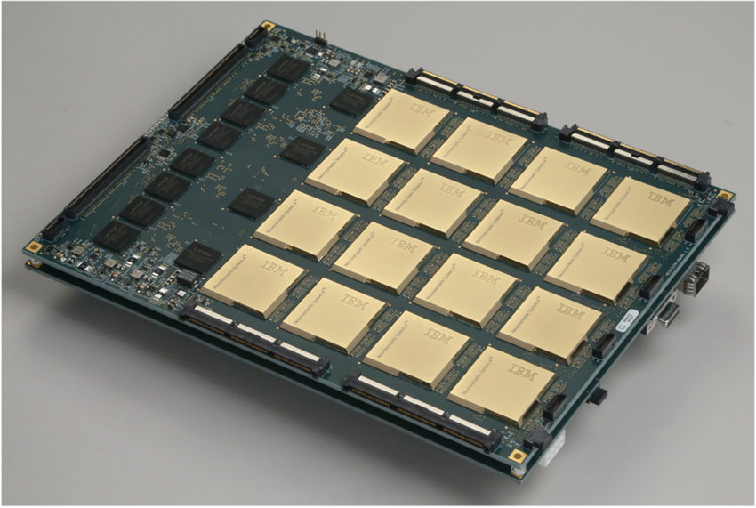
100 billion neurons ~20 W General Intelligence
500 to 1000 times efficiency difference
1 billion neurons ~100 W
Specific Applications
IBM TrueNorth 2019

Slide 4
How it works
Pre-synaptic
Post-synaptic
synapse
synapse

Slide 5
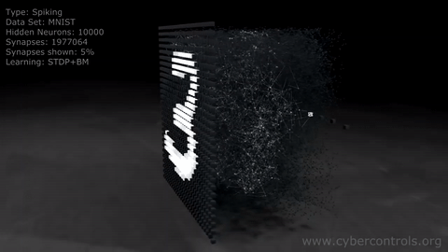
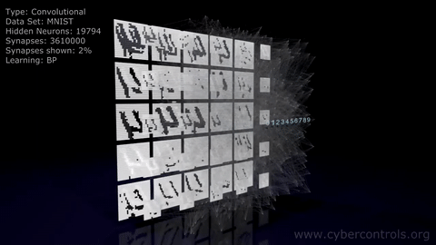
How it works
3D animation created by Denis Dmitriev for cybercontrols.org
Available at: https://www.youtube.com/watch?v=3JQ3hYko51Y

Slide 6
1 x 3 kernel
1 x 3 kernel
99
Max-Pooling Layer
Hidden Layer
13
Input Layer

Slide 7
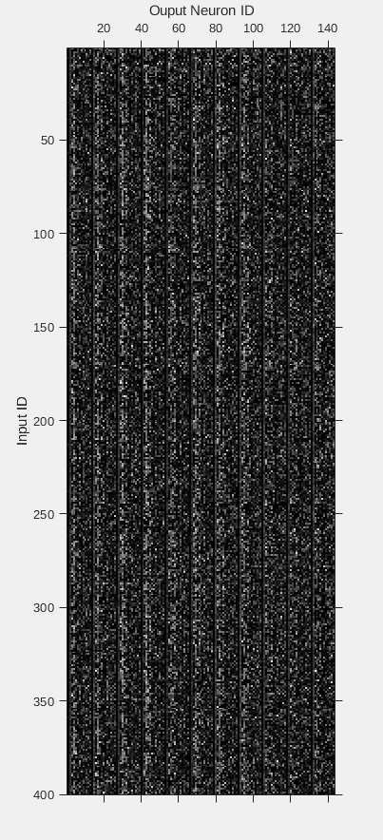
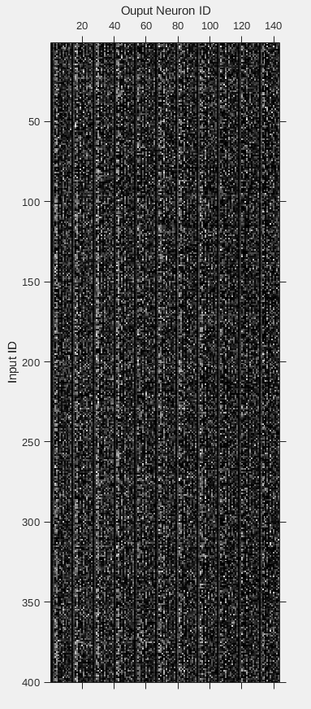
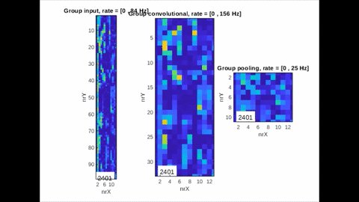
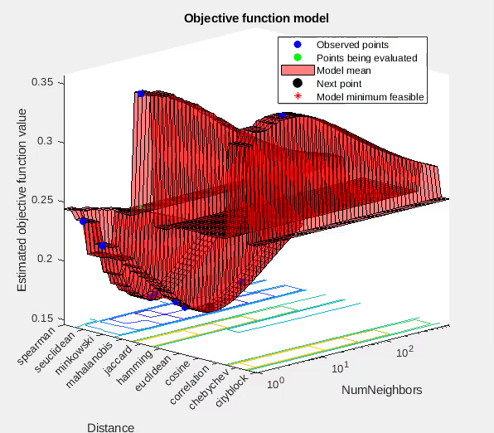
Results
SNN all layers’ activity
Male(left) & Female(right) spike outputs used in K-Means clustering
MATLAB fitcknn output

Slide 8
Future Works
Making SNN more stable (less runaway behavior)
Having Neurons only fire when it absolutely need to
Implementing lossless input signal encoding technique
Better max-pooling SNN technique
Introducing `hint` network
Optimizing on neuromorphic devices

Slide 9
CNN repr: https://www.superdatascience.com/blogs/the-ultimate-guide-to-convolutional-neural-networks-cnn
SNN repr: https://www.zdnet.com/article/neuromorphic-computing-finds-new-life-in-machine-learning/
Power of Human Brain: https://hypertextbook.com/facts/2001/JacquelineLing.shtml
IBM TrueNorth: http://www.research.ibm.com/articles/brain-chip.shtml

